Slide 1

Tree
Data Structures
Dr. Bouchaib Falah

Slide 2
Storing Many Objects
We have examined 2 major ways to store data in the main memory of the computer
arrays
use subscripts to immediately access elements
fast access, but would consume more memory
linked structures
each node refers to the next in the collection to get to one you often traverse sequentially
maybe slower, but maybe manages memory better

Slide 3
Another Linked Structure
We now turn our attention to another major way of storing data: the Tree
One implementation of a binary tree has nodes with a left and right link field
nodes
root
1
2
3
edges

Slide 4
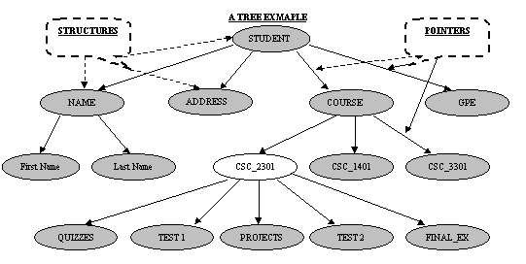
Trees – General Trees
A linked list whose nodes contain more than one pointer – The links are referred to as ‘Edges’

Slide 5
The British Constitution
Crown
Church of
England
House of
Commons
House of
Lords
Supreme
Court
Cabinet
Ministers
County
Council
Metropolitan
police
Rural District
Council
County Borough
Council

Slide 6
More Trees Examples
Unix / Windows file structure

Slide 7
First Some Definitions
A tree has a set of nodes and directed edges that connect them
a directed edge connects a parent to its children
Tree properties
one node is distinguished as the root
every node (except the root) is connected by an edge from exactly one other node
A unique path traverses from the root to each node

Slide 8
General Trees
Trees store data in a hierarchical manner
Root node is A
A's children are B, C, and D
E, F, and D are leaves
Length of path from A to E is 2 edges
A
Trees have layers of nodes,
where some are higher,
others are lower.
B
C
D
E
F

Slide 9
Some Tree Terminology
Node : An element in the tree references data
Root : The node at the very top
Parent : The node directly above another node (except root)
Child : The node(s) below a given node
Size : The number of descendants plus one for the node itself
Leaf : Node with no children
Levels : The root A is at level 0, E and F are at level 2.

Slide 10
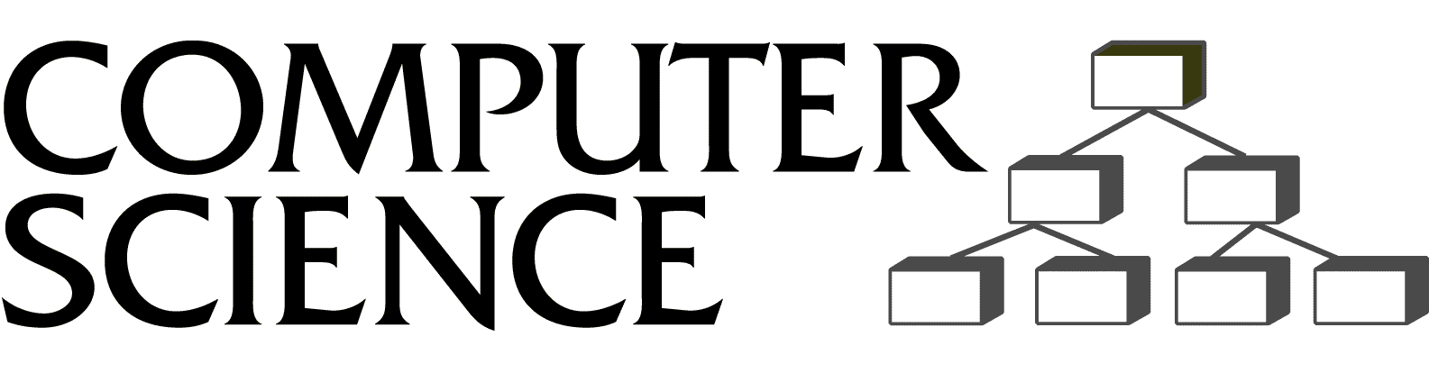
Applications of trees
File Systems
Hierarchical files systems include Unix and DOS
In DOS, each \ represents an edge (In Unix, it's /)
Each directory is a file with a list of all its children
Store large volumes of data
data can be quickly inserted, removed, and found
Data structure used in a variety of situations
implement data vase management systems
compilers: expression tree, symbol tree
The Computer Science
Department's new logo
okay we're working on a new logo
A tree

Slide 11
General Tree Traversal
Two main methods:
Preorder
Postorder
PREorder:
visit the root
traverse in preorder the children (subtrees)
POSTorder
traverse in postorder the children (subtrees)
visit the root

Slide 12
Preorder Traversal
Preorder Traversal
Algorithm: preOrder(v)
“visit” node v
for each child w of v do
recursively perform preOrder(w)

Slide 13
Postorder Traversal
Postorder Traversal
Algorithm: postOrder(v)
for each child w of v do
recursively perform postOrder(w)
“visit” node v
Disk usage command in Unix

Slide 14
Preorder Implementation
public void preorder(ptnode t) {
ptnode ptr;
display(t->key);
for(ptr = t->lchild; ptr!= NULL; ptr = ptr->sibling) {
preorder(ptr);
}
}

Slide 15
Postorder Implementation
public void postorder(ptnode t) {
ptnode ptr;
for(ptr = t->lchild; ptr != NULL; ptr = ptr->sibling) {
postorder(ptr);
}
display(t->key);
}

Slide 16
Binary Trees
N-ary tree has n children max from each node
A binary tree is a tree where all nodes have zero, one or two children
Each node is a leaf, has a right child, has a left child, or has both a left and right child
A
B
C
D
E
F

Slide 17
Binary Tree Defined
A binary tree is either:
an empty tree
consists of a node, called a root, and zero, one, or two children (left and right), each of which are themselves binary trees
This recursive definition uses the term "empty tree" as the base case
Every non-empty node has two children, either of which may be empty
On previous slide, C's left child is an empty tree.

Slide 18
Application: Expression Trees
Binary trees can represent arithmetic expressions
An infix expression will have a parent operator and two children operands:
The expression:
((3+(7*2))-1)
Each parenthesized expression
becomes a tree. Each operand
is a leaf, each operator is
an internal node
-
+
1
3
*
7
2

Slide 19
Evaluating the Expression Tree
To evaluate the expression tree:
Take any two leaves
Apply the parent's operator to them
Replace that operator with the value of the subexpression.
*
*
18
+
3
6
3
2
4

Slide 20
Binary Search Tree
A Binary Search Tree is a binary tree with the following properties:
All items in the left subtree are less than the root.
All items in the right subtree are greater or equal to the root.
Each subtree is itself a binary search tree.

Slide 21
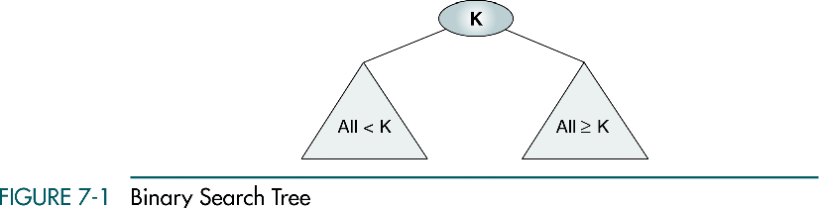
BST Basic Property
In a binary search tree:
The left subtree contains key values less than the root
The right subtree contains key values greater than or equal to the root.

Slide 22
BST Basic Concepts
Binary search trees provide an excellent structure for searching a list and at the same time for inserting and deleting data into the list.

Slide 23
BST Operations
We will discuss four basic BST operations: traversal, search, insert, and delete; and develop algorithms for searches, insertion, and deletion.
Traversal
Search
Insertion
Deletion

Slide 24
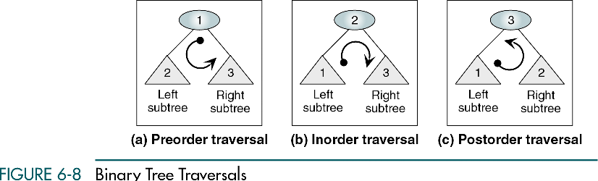
Binary Tree Traversals

Slide 25
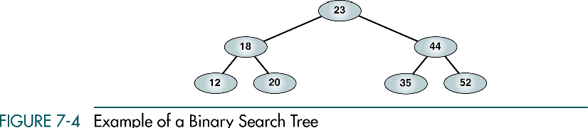
Binary Search Tree Example

Slide 26
Preorder Traversal
23 18 12 20 44 35 52

Slide 27
Postorder Traversal
12 20 18 35 52 44 23

Slide 28
Inorder Traversal
12 18 20 23 35 44 52
Inorder traversal of a binary search tree produces a sequenced list

Slide 29
Right-Node-Left Traversal
52 44 35 23 20 18 12
Right-node-left traversal of a binary search tree produces a descending sequence

Slide 30
Three BST search algorithms:
Find the smallest node
Find the largest node
Find a requested node

Slide 31
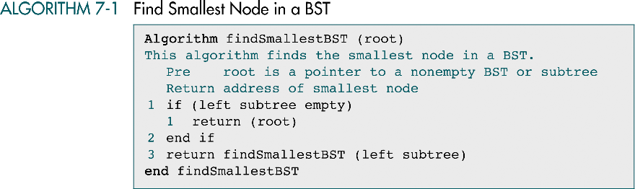
Smallest Node in a BST

Slide 32
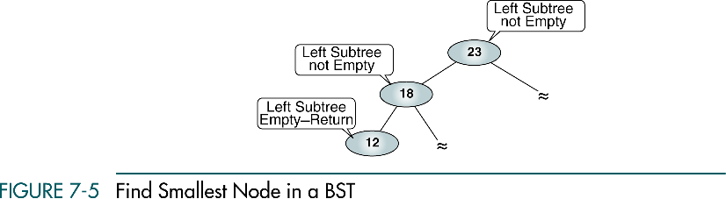
Example: Smallest in a BST

Slide 33
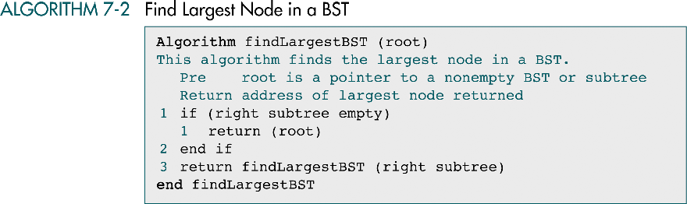
Largest Node in a BST

Slide 34
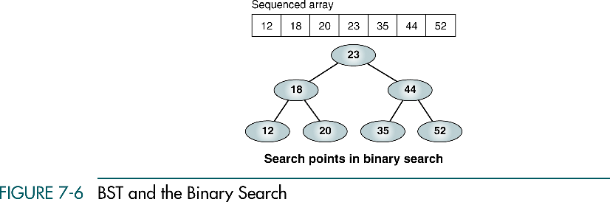
Example: Largest in a BST

Slide 35
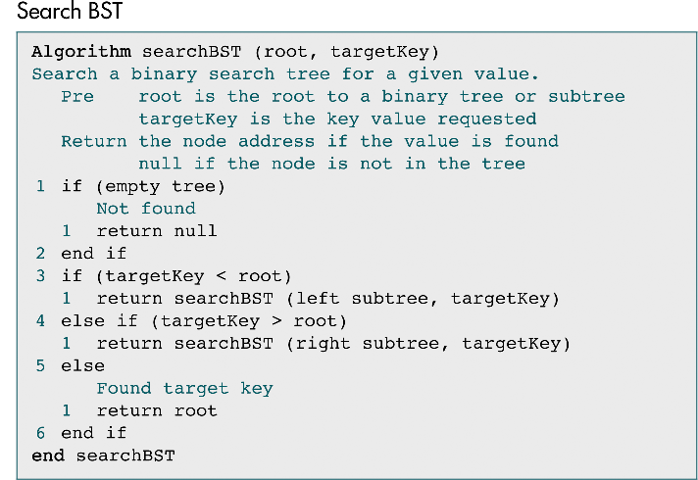
Requested Node in a BST

Slide 36
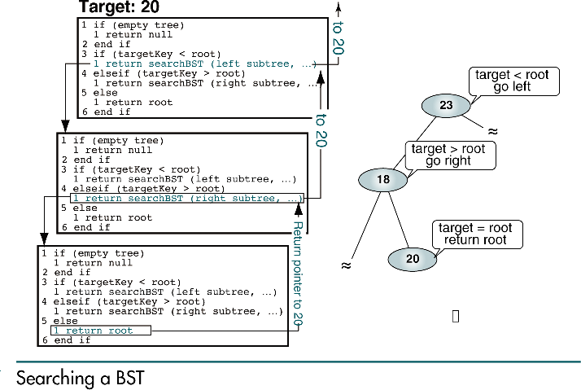
Example: Requested in a BST

Slide 37
BST Insertion
To insert data all we need to do is follow the branches to an empty subtree and then insert the new node.
In other words, all inserts take place at a leaf or at a leaflike node – a node that has only one null subtree.

Slide 38
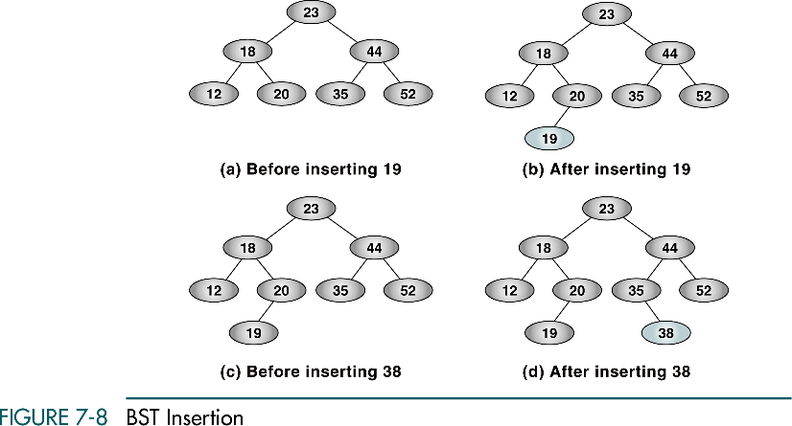
Example: BST Insertion

Slide 39
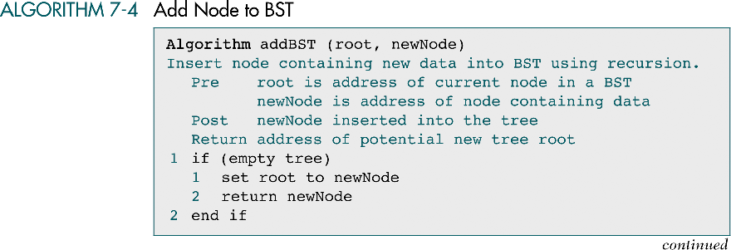
BST Insertion Algorithm

Slide 40
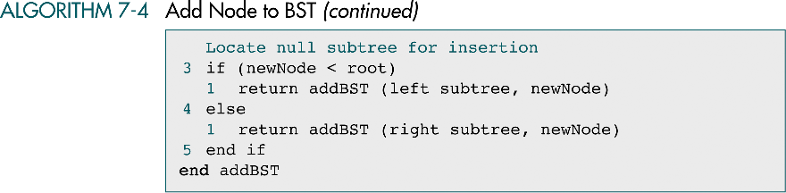
BST Insertion Algorithm- Con

Slide 41
BST Deletion
There are the following possible cases when we delete a node:
The node to be deleted is a leaf (has no children). In this case, all we need to do is delete the node.
The node to be deleted has only a right subtree. We delete the node and attach the right subtree to the deleted node’s parent.
The node to be deleted has only a left subtree. We delete the node and attach the left subtree to the deleted node’s parent.
The node to be deleted has two subtrees. It is possible to delete a node from the middle of a tree, but the result tends to create very unbalanced trees.

Slide 42
Deletion from the middle of a tree
Rather than simply delete the node, we try to maintain the existing structure as much as possible by finding data to take the place of the deleted data. This can be done in one of two ways.

Slide 43
Deletion from the middle of a tree
We can find the largest node in the deleted node’s left subtree and move its data to replace the deleted node’s data.
We can find the smallest node on the deleted node’s right subtree and move its data to replace the deleted node’s data.
Either of these moves preserves the integrity of the binary search tree.

Slide 44
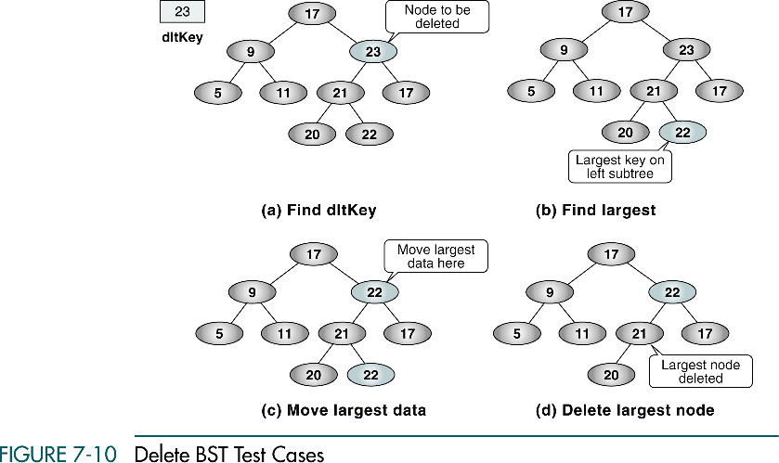
Example: BST Deletion from the Middle
27
27
27
27

Slide 45
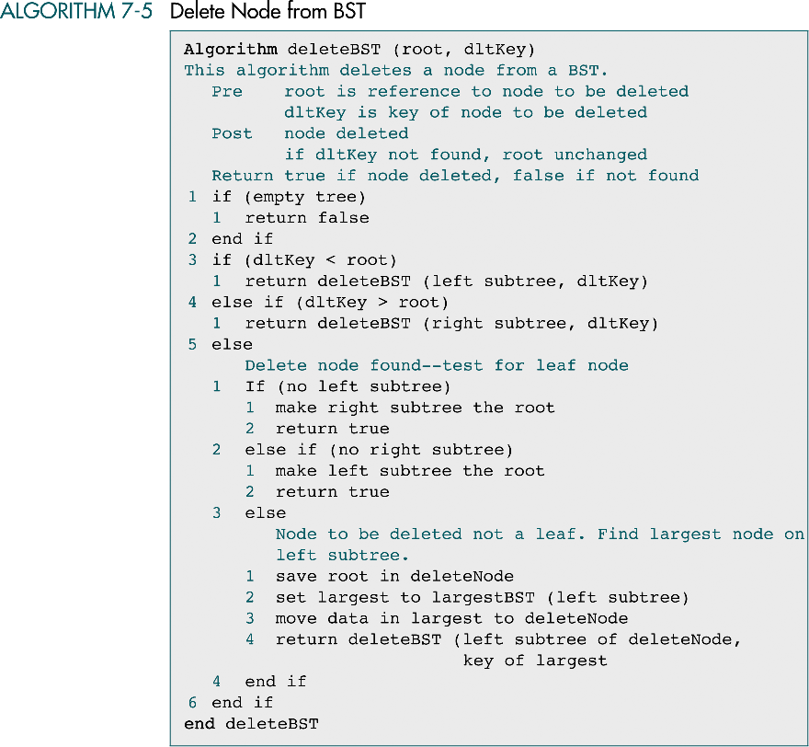
BST Deletion Algorithm

Slide 46
BST Deletion Algorithm

Slide 47
Preorder Traversal with a Stack
Push the root onto the stack.
While the stack is not empty
pop the stack and visit it
push its two children
14
Stack
14
84
43
13
16
33
97
53
99
72
64

Slide 48
Preorder Traversal with a Stack
Push the root onto the stack.
While the stack is not empty
pop the stack and visit it
push its two children
84
43
14
Stack
14
84
43
13
16
33
97
53
99
72
64

Slide 49
Preorder Traversal with a Stack
Push the root onto the stack.
While the stack is not empty
pop the stack and visit it
push its two children
13
16
43
14 84
Stack
14
84
43
13
16
33
97
53
99
72
64

Slide 50
Preorder Traversal with a Stack
Push the root onto the stack.
While the stack is not empty
pop the stack and visit it
push its two children
53
16
43
14 84 13
Stack
14
84
43
13
16
33
97
53
99
72
64

Slide 51
Preorder Traversal with a Stack
Push the root onto the stack.
While the stack is not empty
pop the stack and visit it
push its two children
16
43
14 84 13 53
Stack
14
84
43
13
16
33
97
53
99
72
64

Slide 52
Preorder Traversal with a Stack
Push the root onto the stack.
While the stack is not empty
pop the stack and visit it
push its two children
99
72
43
14 84 13 53 16
Stack
14
84
43
13
16
33
97
53
99
72
64

Slide 53
Preorder Traversal with a Stack
Push the root onto the stack.
While the stack is not empty
pop the stack and visit it
push its two children
72
43
14 84 13 53 16 99
Stack
14
84
43
13
16
33
97
53
99
72
64

Slide 54
Preorder Traversal with a Stack
Push the root onto the stack.
While the stack is not empty
pop the stack and visit it
push its two children
43
14 84 13 53 16 99 72
Stack
14
84
43
13
16
33
97
53
99
72
64

Slide 55
Preorder Traversal with a Stack
Push the root onto the stack.
While the stack is not empty
pop the stack and visit it
push its two children
33
97
14 84 13 53 16 99 72 43
Stack
14
84
43
13
16
33
97
53
99
72
64

Slide 56
Preorder Traversal with a Stack
Push the root onto the stack.
While the stack is not empty
pop the stack and visit it
push its two children
64
97
14 84 13 53 16 99 72 43 33
Stack
14
84
43
13
16
33
97
53
99
72
64

Slide 57
Preorder Traversal with a Stack
Push the root onto the stack.
While the stack is not empty
pop the stack and visit it
push its two children
97
14 84 13 53 16 99 72 43 33 64
Stack
14
84
43
13
16
33
97
53
99
72
64

Slide 58
Preorder Traversal with a Stack
Push the root onto the stack.
While the stack is not empty
pop the stack and visit it
push its two children
14 84 13 53 16 99 72 43 33 64 97
Stack
14
84
43
13
16
33
97
53
99
72
64

Slide 59
Preorder Traversal with a Stack
Push the root onto the stack.
While the stack is not empty
pop the stack and visit it
push its two children
14 84 13 53 16 99 72 43 33 64 97
Stack
14
84
43
13
16
33
97
53
99
72
64

